Slide 1
Computer software
Unit 6

Slide 2
Operating system
An Operating System (OS) is an interface between a computer user and computer hardware. An operating system is a software which performs all the basic tasks like file management, memory management, process management, handling input and output, and controlling peripheral devices such as disk drives and printers.
Some popular Operating Systems include Linux, Windows, OS X, VMS, OS/400, AIX, z/OS, etc.

Slide 3
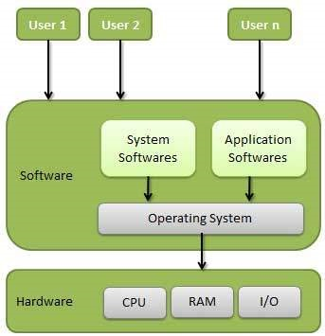

Slide 4
Following are some of important functions of an operating System.
Memory Management
Process Management
Device Management
File Management
Security
User Interface
Control over system performance
Job accounting
Error detecting aids
Coordination between other software and users

Slide 5
Memory Management
Memory management refers to management of Primary Memory or Main Memory. Main memory is a large array of words or bytes where each word or byte has its own address.
Main memory provides a fast storage that can be accessed directly by the CPU. For a program to be executed, it must in the main memory. An Operating System does the following activities for memory management −
Keeps tracks of primary memory, i.e., what part of it are in use by whom, what part are not in use.
In multiprogramming, the OS decides which process will get memory when and how much.
Allocates the memory when a process requests it to do so.
De-allocates the memory when a process no longer needs it or has been terminated.

Slide 6
Process Management
A program in execution is called a process. In order to accomplish its task, process needs the computer resources.
There may exist more than one process in the system which may require the same resource at the same time. Therefore, the operating system has to manage all the processes and the resources in a convenient and efficient way.
Some resources may need to be executed by one process at one time to maintain the consistency otherwise the system can become inconsistent and deadlock may occur.
The operating system is responsible for the following activities in connection with Process Management
Scheduling processes and threads on the CPUs.
Creating and deleting both user and system processes.
Suspending and resuming processes.
Providing mechanisms for process synchronization.
Providing mechanisms for process communication.

Slide 7
Device Management
An Operating System manages device communication via their respective drivers. It does the following activities for device management −
Keeps tracks of all devices. Program responsible for this task is known as the I/O controller.
Decides which process gets the device when and for how much time.
Allocates the device in the efficient way.
De-allocates devices.

Slide 8
File Management
A file system is normally organized into directories for easy navigation and usage. These directories may contain files and other directories.
An Operating System does the following activities for file management −
Keeps track of information, location, uses, status etc. The collective facilities are often known as file system.
Decides who gets the resources.
Allocates the resources.
De-allocates the resources.

Slide 9
Protection and security:
Protection refers to a mechanism or a way to control the access of programs, processes, or users to the resources defined by a computer system. Following are the major activities of an operating system with respect to protection
The OS ensures that all access to system resources is controlled.
The OS ensures that external I/O devices are protected from invalid access attempts.
The OS provides authentication features for each user by means of passwords.

Slide 10
User Interface:
User interface helps to communicate between the user and the computer.
Its types are:
Command line Interface(CLI)
Graphical User Interface(GUI)

Slide 11
Control over system performance − Recording delays between request for a service and response from the system.
Job accounting − Keeping track of time and resources used by various jobs and users.
Error detecting aids − Production of dumps, traces, error messages, and other debugging and error detecting aids.
Coordination between other softwares and users − Coordination and assignment of compilers, interpreters, assemblers and other software to the various users of the computer systems.

Slide 12
Types of Operating System
Batch operating system
Time-sharing operating systems
Distributed operating System
Network operating System
Real Time operating System
Hard real-time systems
Soft real-time systems

Slide 13
1) Batch operating system
A Batch Operating System is one of the earliest types of operating systems designed for mainframe computers. In this system, jobs or tasks are grouped together into "batches" and executed sequentially without direct user interaction during execution. This system was widely used in the 1950s and 1960s.
Examples of Batch Operating Systems:
Early IBM operating systems like IBM OS/360.

Slide 14
Advantages:
Efficient Resource Utilization: CPU and I/O devices are kept busy, reducing idle time.
Automation: Once the batch is submitted, no manual intervention is required.
Reduced Setup Time: Jobs with similar requirements can be grouped together to reduce setup time.

Slide 15
Disadvantages:
No Interaction During Execution: Users cannot interact with their programs during execution.
Debugging Difficulty: Errors are identified only after the entire batch is processed, making debugging time-consuming.
Latency: Users must wait until their batch is processed to see results.

Slide 16
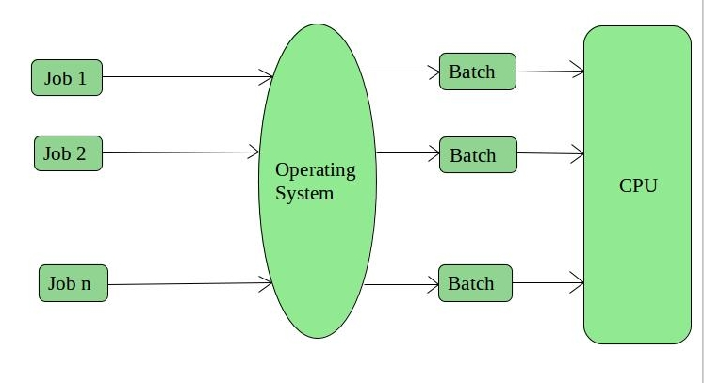
Fig. Batch operating system

Slide 17
2) Time-Sharing Operating Systems
Each task has given some time to execute, so that all the tasks work smoothly. Each user gets time of CPU as they use single system. These systems are also known as Multitasking Systems. The task can be from single user or from different users also. The time that each task gets to execute is called quantum. After this time interval is over OS switches over to next task.

Slide 18
Cont.
Advantages of Time-Sharing OS:
Each task gets an equal opportunity
Less chances of duplication of software
CPU idle time can be reduced
Disadvantages of Time-Sharing OS:
Reliability problem
One must have to take care of security and integrity of user programs and data
Data communication problem
Examples of Time-Sharing OSs are: Multics, Unix etc.

Slide 19
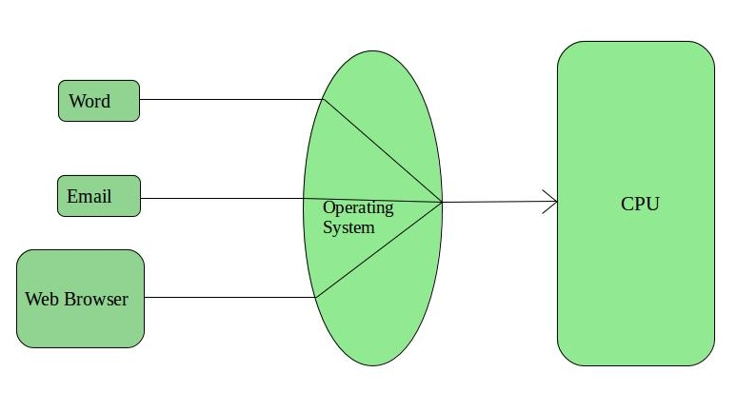
Cont.

Slide 20
3) Distributed Operating System
A distributed operating system manages a collection of independent computers and presents them as a single system to users. These systems enable seamless communication, resource sharing, and task execution across multiple machines in a network.
The major benefit of working with these types of operating s,ystem is that it is always possible that one user can access the files or software which are not actually present on his system but on some other system connected within this network i.e., remote access is enabled within the devices connected in that network. Examples: Apache Hadoop, Amoeba, Microsoft Azure, Solaris

Slide 21
Cont.
Advantages of Distributed Operating System:
Failure of one will not affect the other network communication, as all systems are independent from each other
Since resources are being shared, computation is highly fast and durable
Load on host computer reduces
These systems are easily scalable as many systems can be easily added to the network
Delay in data processing reduces
Disadvantages of Distributed Operating System:
Failure of the main network will stop the entire communication
To establish distributed systems the language which are used are not well defined yet.

Slide 22
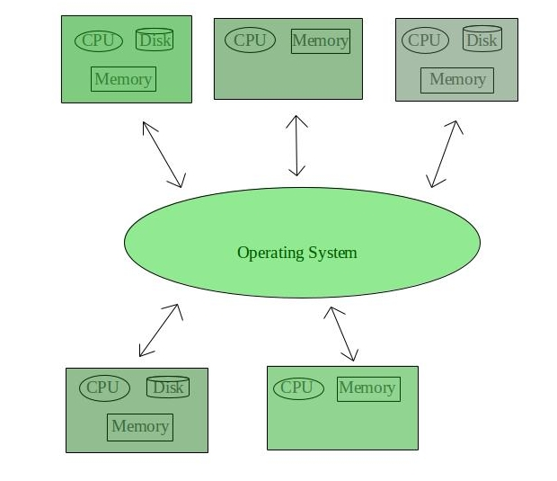
Fig. Distributed Operating System

Slide 23
4) Network Operating System
These systems runs on a server and provides the capability to manage data, users, groups, security, applications, and other networking functions. These type of operating systems allows shared access of files, printers, security, applications, and other networking functions over a small private network.
Examples of Network Operating System are: Microsoft Windows Server 2003, Microsoft Windows Server 2008, UNIX, Linux, Mac OS X, Novell NetWare, and BSD etc.

Slide 24
Cont.
Advantages of Network Operating System:
Highly stable centralized servers
Security concerns are handled through servers
Server access are possible remotely from different locations and types of systems
Disadvantages of Network Operating System:
Servers are costly
User has to depend on central location for most operations
Maintenance and updates are required regularly

Slide 25
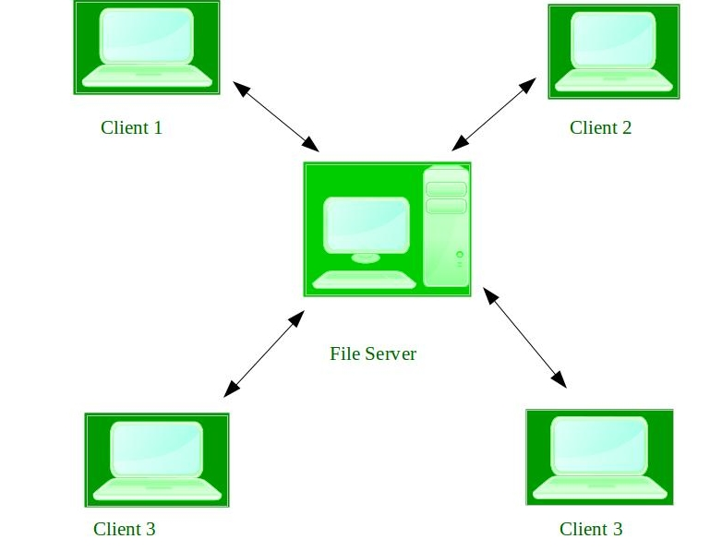
Fig. Network Operating System –

Slide 26
5. Real-Time Operating System –
These types of OSs serves the real-time systems. The time interval required to process and respond to inputs is very small. This time interval is called response time.
Real-time systems are used when there are time requirements are very strict like missile systems, air traffic control systems, robots etc.
Two types of Real-Time Operating System which are as follows:
Hard Real-Time Systems: These OSs are meant for the applications where time constraints are very strict and even the shortest possible delay is not acceptable. These systems are built for saving life like automatic parachutes or air bags which are required to be readily available in case of any accident.
Soft Real-Time Systems: These OSs are for applications where for time-constraint is less strict. Eg: web.
Examples of Real-Time Operating Systems are: Scientific experiments, medical imaging systems, industrial control systems, weapon systems, robots, air traffic control systems, etc.

Slide 27
Advantages of RTOS:
Maximum Consumption: Maximum utilization of devices and system, thus more output from all the resources
Task Shifting: Time assigned for shifting tasks in these systems are very less. For example in older systems it takes about 10 micro seconds in shifting one task to another and in latest systems it takes 3 micro seconds.
Focus on Application: Focus on running applications and less importance to applications which are in queue.
Real time operating system in embedded system: Since size of programs are small, RTOS can also be used in embedded systems like in transport and others.
Error Free: These types of systems are error free.

Slide 28
Disadvantages of RTOS:
Complex Algorithms: The algorithms are very complex and difficult for the designer to write on.
Device driver and interrupt signals: It needs specific device drivers and interrupt signals to response earliest to interrupts.

Slide 29
6) Multiprogramming OS
In a multiprogramming system there are one or more programs loaded in main memory which are ready to execute. Only one program at a time is able to get the CPU for executing its instructions while all the others are waiting their turn. The main idea of multiprogramming is to maximize the use of CPU time. Indeed, suppose the currently running process is performing an I/O task . Then, the OS may interrupt that process and give the control to one of the other in-main-memory programs that are ready to execute (i.e. process context switching). In this way, no CPU time is wasted by the system waiting for the I/O task to be completed, and a running process keeps executing until either it voluntarily releases the CPU or when it blocks for an I/O operation. Therefore, the ultimate goal of multiprogramming is to keep the CPU busy as long as there are processes ready to execute.

Slide 30
7) Multiprocessing/Parallel Processing OS
Multiprocessing sometimes refers to executing multiple processes (programs) at the same time. Multiprocessing refers to the hardware (i.e., the CPU units) rather than the software (i.e., running processes). If the underlying hardware provides more than one processor then that is multiprocessing.

Slide 31
Process
A process is a program in execution. The execution of a process must progress in a sequential fashion. Definition of process is following.
A process is defined as an entity which represents the basic unit of work to be implemented in the system.

Slide 32
Components of process are following.
S.N. | Component & Description
1 | Object Program Code to be executed.
2 | Data Data to be used for executing the program.
3 | Resources While executing the program, it may require some resources.
4 | Status Verifies the status of the process execution.A process can run to completion only when all requested resources have been allocated to the process. Two or more processes could be executing the same program, each using their own data and resources.

Slide 33
Program
A program by itself is not a process. It is a static entity made up of program statement while process is a dynamic entity. Program contains the instructions to be executed by processor.
A program takes a space at single place in main memory and continues to stay there. A program does not perform any action by itself.

Slide 34
Process States
As a process executes, it changes state. The state of a process is defined as the current activity of the process.
Process can have one of the following five states at a time which are given below:
New
Ready
Running
Waiting
Terminated

Slide 35
Cont.
S.N. | State & Description
1 | New The process is being created.
2 | Ready The process is waiting to be assigned to a processor. Ready processes are waiting to have the processor allocated to them by the operating system so that they can run.
3 | Running Process instructions are being executed (i.e. The process that is currently being executed).
4 | Waiting The process is waiting for some event to occur (such as the completion of an I/O operation).
5 | Terminated

Slide 36
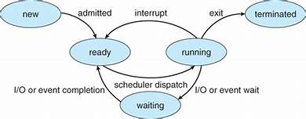
Fig: Process State diagram

Slide 37
CPU Scheduling
In Multiprogramming systems, the Operating system schedules the processes on the CPU to have the maximum utilization of it and this procedure is called CPU scheduling.
CPU scheduling can be categorized into two main types:
1. Preemptive Scheduling
In preemptive scheduling, a running process can be interrupted and moved back to the ready queue to allow another process to run.
It is suitable for real-time and multitasking systems where higher-priority tasks must interrupt lower-priority ones.
2. Non-Preemptive Scheduling
In non-preemptive scheduling, a running process cannot be interrupted until it finishes or voluntarily releases the CPU (e.g., by waiting for I/O).
It is simpler to implement but can lead to poor CPU utilization or starvation in some scenarios.

Slide 38
The Operating System uses various scheduling algorithm to schedule the processes. The different CPU scheduling algorithm are given below:
First come First served(FCFS) Scheduling
Shortest Job First(SJF) Scheduling
Round Robin(RR) Scheduling.
Shortest remaining time first Scheduling
Priority based Scheduling

Slide 39
1) First come First served(FCFS) Scheduling
It is the simplest algorithm to implement. The process with the minimal arrival time will get the CPU first. The lesser the arrival time, the sooner will the process gets the CPU. It is the non-preemptive type of scheduling.

Slide 40
2) Shortest Job First
The job with the shortest burst time will get the CPU first. The lesser the burst time, the sooner will the process get the CPU. It is the non-preemptive type of scheduling.

Slide 41
3) Round Robin
In the Round Robin scheduling algorithm, the OS defines a time quantum (slice). All the processes will get executed in the cyclic way. Each of the process will get the CPU for a small amount of time (called time quantum) and then get back to the ready queue to wait for its next turn. It is a preemptive type of scheduling.

Slide 42
4) Shortest remaining time first
It is the preemptive form of SJF. In this algorithm, the OS schedules the Job according to the remaining time of the execution.

Slide 43
5) Priority based scheduling
In this algorithm, the priority will be assigned to each of the processes. The higher the priority, the sooner will the process get the CPU. If the priority of the two processes is same then they will be scheduled according to their arrival time.

Slide 44
Deadlock:
A Deadlock is a situation where each of the computer process waits for a resource which is being assigned to some another process. In this situation, none of the process gets executed since the resource it needs, is held by some other process which is also waiting for some other resource to be released.
Let us assume that there are three processes P1, P2 and P3. There are three different resources R1, R2 and R3. R1 is assigned to P1, R2 is assigned to P2 and R3 is assigned to P3.
After some time, P1 demands for R2 which is being used by P2. P1 halts its execution since it can't complete without R2. P2 also demands for R3 which is being used by P3. P2 also stops its execution because it can't continue without R3. P3 also demands for R1 which is being used by P1 therefore P3 also stops its execution.
In this scenario, a cycle is being formed among the three processes. None of the process is progressing and they are all waiting. The computer becomes unresponsive since all the processes got blocked.

Slide 45
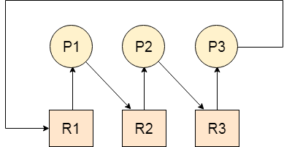
Fig. Deadlock

Slide 46
Necessary conditions for Deadlocks
Deadlocks occur when all the following four conditions are met simultaneously (Coffman conditions):
Mutual Exclusion
At least one resource must be held in a non-shareable mode, meaning only one process can use the resource at a time.
Hold and Wait
A process holding at least one resource is waiting to acquire additional resources currently held by other processes.
No Preemption
Resources cannot be forcibly removed from a process holding them; they can only be released voluntarily by the process.
Circular Wait
A set of processes {P1, P2, ..., Pn} exists such that P1 is waiting for a resource held by P2, P2 is waiting for a resource held by P3, and so on, with Pn waiting for a resource held by P1.

Slide 47
Strategies for handling Deadlock :
1. Deadlock prevention
2. Deadlock avoidance
3. Deadlock detection and recovery
4. Deadlock Ignorance

Slide 48
1) Deadlock Prevention
Modify the system to ensure at least one of the four conditions for deadlock cannot hold. For example:
Mutual Exclusion: Make resources shareable where possible.
Hold and Wait: Require processes to request all resources at once.
No Preemption: Allow preemption of resources under specific conditions.
Circular Wait: Impose a strict order in which resources must be requested.

Slide 49
2) Deadlock Avoidance
Dynamically analyze resource allocation requests and decide whether granting a request could lead to a deadlock.
Example: Banker's Algorithm, which ensures that a safe state is maintained.

Slide 50
3) Deadlock Detection and Recovery
Allow deadlocks to occur but detect them and take corrective action, such as:
Terminating processes involved in the deadlock.
Preempting resources from some processes.
Using a Resource Allocation Graph (RAG) for detection.

Slide 51
4) Ignore the Problem
In some systems (e.g., most desktop operating systems), deadlocks are rare and are simply ignored. This is known as the ostrich algorithm.

Slide 52
Paging:
In Operating Systems, Paging is a storage mechanism used to retrieve processes from the secondary storage into the main memory in the form of pages.
The main idea behind the paging is to divide each process in the form of pages. The main memory will also be divided in the form of frames.
One page of the process is to be stored in one of the frames of the memory. The pages can be stored at the different locations of the memory but the priority is always to find the contiguous frames or holes.
Pages of the process are brought into the main memory only when they are required otherwise they reside in the secondary storage.

Slide 53
Virtual Memory
Virtual Memory is a storage scheme that provides user an illusion of having a very big main memory. This is done by treating a part of secondary memory as the main memory.
In this scheme, User can load the bigger size processes than the available main memory by having the illusion that the memory is available to load the process.
Instead of loading one big process in the main memory, the Operating System loads the different parts of more than one process in the main memory.
By doing this, the degree of multiprogramming will be increased and therefore, the CPU utilization will also be increased.

Slide 54
User Interface:
User interface helps to communicate between the user and the computer.
Its types are:
Command line Interface(CLI)
Graphical User Interface(GUI)

Slide 55
Command line Interface(CLI)
CLI requires the user to interact with OS in the form of text keyed in from the keyboard.
User has to remember all the commands to perform the task.
Eg are MS-DOS and Linux shell .

Slide 56
Graphical User Interface(GUI)
It uses graphics to give the commands.
The interface consists of icons, menus, windows and pointers.
The user do not need to remember the commands.
Eg windows 7, windows 10

Slide 57
Example of os:
MS-DOS
Windows Family OS.
Linux OS.

Slide 58
Linux OS
It was developed by Linus Torvalds in 1992. Linux is copyright under the GNU("GNU's Not Unix!") public License.
Linux is free operating system that is easily available.
Linux is command line user interface OS, Linux has GUI interaces called desktop environments like GNOME(GNU Object Model Environment).
Its vendor are Red Hat, Mandrake etc
It is reliable and secure OS.
It supports multi-tasking, multi processing.
Eg Ubuntu, Redhat linux, kali linux etc.

Slide 59
Thank You

